Slide 1
Knowledge Mining With Azure Search & Cognitive Services
Microsoft Confidential

Slide 2
Knowledge Mining Seller Execution Guide
Why Knowledge Mining
Knowledge Mining Opportunity with Azure Search & Cognitive Services
What Accounts should I target and how do I identify those accounts
Sales Engagement Process & ECIF Guidance
Who are our Partners & Partner engagement guidance
Execution Resources and Call to Action

Slide 3
Knowledge Mining Opportunity
Notes:
KJ + AVP

Slide 4
Turning DATA into KNOWLEDGE with AI powered search.
What IS Knowledge Mining?
The use of advanced data science to understand relationships across multiple sources of structured & unstructured data in a human-like fashion in order to uncover critical business insights and deliver transformational outcomes
Notes:
The use of advanced data science to understand relationships across multiple sources of structured & unstructured data in a human-like fashion in order to uncover critical business insights and deliver transformational outcomes

Slide 5
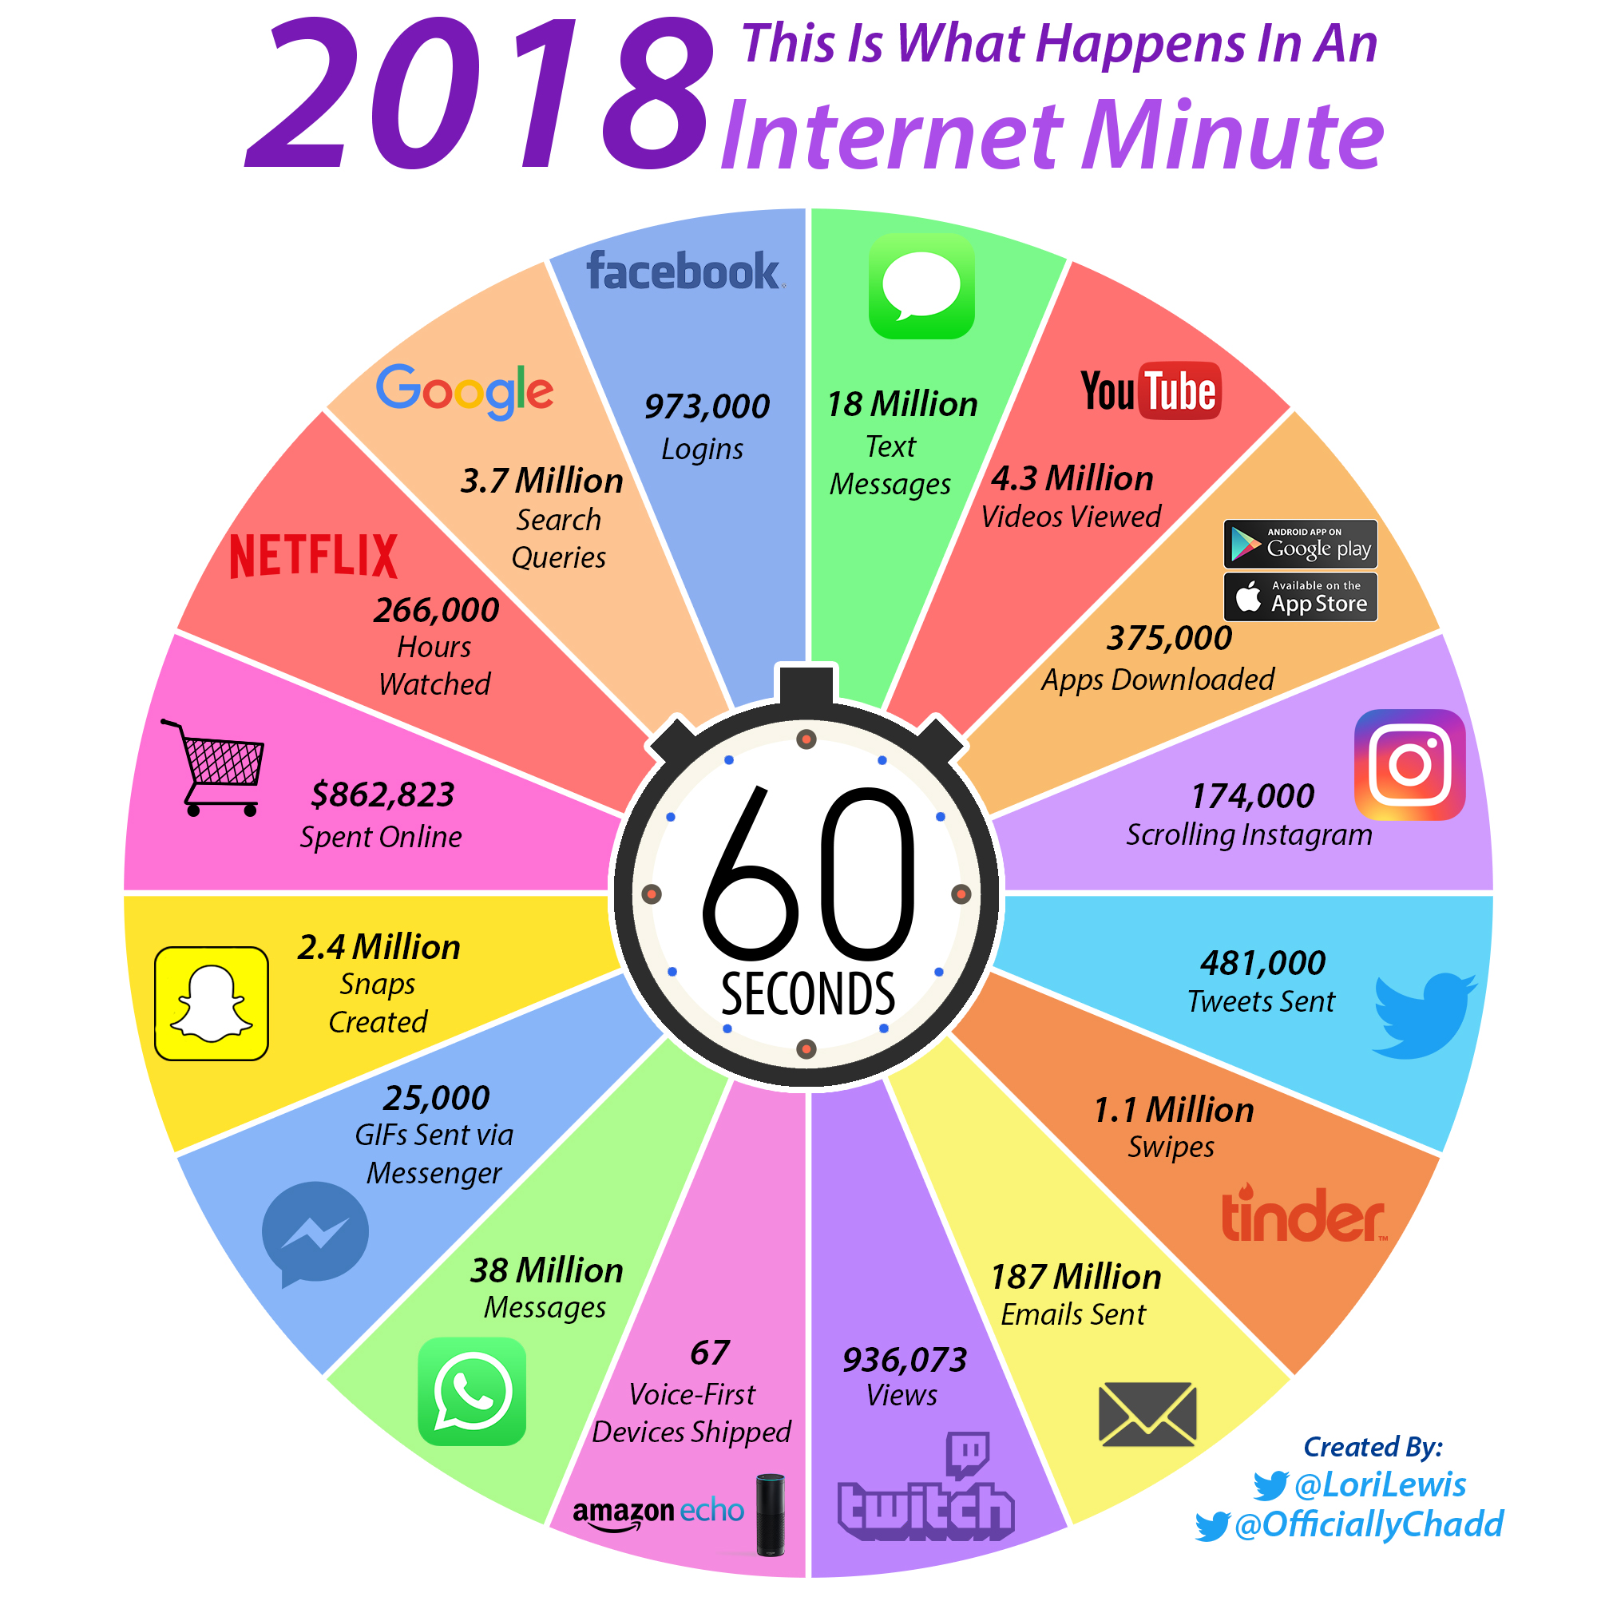
Why Knowledge Mining?
Why Now?
2.5 quintillion bytes of new data per day including email, documents, images, videos, & smart device data
80% of this business data is estimated to be unstructured
Starting now, companies MUST begin making use of this data to transform their business or risk being left behind

Slide 6



Business Impacts of Exponential Data Growth
Companies need to handle larger volumes of data
Data is coming in more formats such as images and video
Results in a loss of productivity and money
30x increase
300 hours
$14,209 lost
in the amount of digital information companies consume by 2020¹
of video uploaded every minute to YouTube alone²
per year per knowledge worker by companies due to information searches¹
¹Managed Print and Document Services for Controlling Today’s, and Tomorrow’s, Information Costs; ²In the next 60 seconds 300 hours of video will be uploaded to YouTube
Notes:
Data is growing exponentially, leading to:
Challenges for outdated and manual methods of categorizing and organizing information to keep up with growth
New business problems due to the additional time it takes for employees and end-customers to comb through potentially relevant information to find what they need to make decisions
As a result, companies/developers
Overspend or inefficiently documenting their information
Fail to unlock valuable information lying latent in content
Take too long to make decisions that are reliant on their data
Impacts any company or developer needing to explore/surface a large amount of information quickly, repeatedly, and/or accurately
How these issues play out:
Cannot leverage all of their data because of it’s format (images, handwritten text, PPT, PDF).
Search/explore their data in very shallow ways with unsophisticated indexers that don’t understand the intent of the “searcher”
Search/explore their data in very shallow ways because they couldn’t fully enrich/annotate their data
Cannot identify relationships between documents/items within their database
Struggle to optimize/prioritize the right content to their end users
Must upkeep/manage/retool/apply additional logic and entity extraction to their data as it changes or if they want to explore it more deeply
Links
1. https://www.ricoh.nl/Images/IDC_Executive_Insights_January2011_t_76-4420.pdf
2. http://www.marketingpilgrim.com/2014/12/in-the-next-60-seconds-300-hours-of-video-will-be-uploaded-to-youtube.html

Slide 7
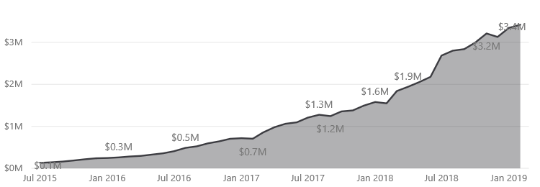
Knowledge Mining Growth and Execution
The Numbers
Largest revenue driver in Azure AI portfolio and growing strong
Retires Azure Core Products Quota – 2x QUOTA REDUCTION!
Available today in preview with over 700+ customers ALREADY
New customers being added every month - 75% growth for HiPo accounts & 67% for mainstream accounts post announce
Largest Customer - ~$100K PER MONTH ACR TTM – First workloads running <4 mos
Engage and Operationalize
Low barrier to entry - use cases move forward quickly
Average POC runs 3-4 weeks
Complementary Azure analytics and cognitive services provide additional intelligent capabilities for data search and analysis.
In accounts that start consuming AI in their first month on Azure we see a consistently higher average ACR than accounts who do not
Notes:
Include Cosmos DB synergies here (per Alessio’s input) and why Cosmos vs. Azure SQL, DB and Cosmos (for downstream analytics scenarios)

Slide 8
Knowledge Mining – Azure & Cognitive Search
Azure Search
Cognitive Search Process
Data
Ingestion
Search index
Cognitive Skills
Enrichment
Identify storage types which can contain a variety of data formats
Crawl through your data via pull APIs and indexers
“Crack” open unstructured data (PDFs, Word…)
Extract text using OCR, identify Key Phrases, Peoples Names,​ Company Names, Analyze Sentiment, Computer Vision,​ etc.
Annotate and enrich with cognitive services and custom skills
Include Third Party Enrichers​ Custom classification models,​ Custom entity extraction,​ etc.​
Organize data in an index to make it searchable
Notes:
PG Feedback: way too MSFT centric – if I’m a customer this doesn’t put me at the center at all – flip this slide to a customer’s ecosystem.
My data/structured and unstructured data – (graphically put that at the center of the graphic, then wheel around that the different components)
Be specific about the cognitive skills that exist that we can lever in to enrich – highlight this competitive advantage

Slide 9
Why Azure for Knowledge Mining?
Fully managed search experience
One-click integration of AI services
Customize to your specific business needs
Secure and reliable
AI-optimized and industry leading ingestion, annotation, and indexing capabilities, out-of-the-box
Fully managed service that you can configure rather than code
Use any Azure storage solution and easily schedule to update on a regular time interval
Document cracking + OCR ingests both structured and unstructured data
Indexing evolved to derive the true intent of a query with analyzers fine-tuned across languages, suggestions, scoring/ranking you can configure,
Choose from a variety of Cognitive Skills to derive more understanding from your data
Vision
Language
Speech
Search Services
Knowledge
Orchestrate custom AI models and run updates only on the section of the solution you need
Custom skills to train your data
Classifications models
Entity extraction
Scoring models
Custom analyzers
Complex type shaping
Built for the scale and performance needs of enterprises, with advanced security and privacy features
SLA of 99.9% availability with industry leading privacy and security
FedRamp
ISO 27001:2013
SOC 2Type 2
GxP (21 CFR Part 11)
HIPPAA and the HITECH act
HITRUST
PCI DSS Level 1
Australia IRAP Unclassified
Azure Search Compete FAQ

Slide 10
What can you do with Knowledge Mining?
Enterprise Search
Easily add sophisticated search capabilities to your internal LOB applications using the same integrated Microsoft natural language stack that's used in Bing and Office and that’s been improved over 16 years.
Application Integration
Integrate Search and Cognitive capabilities into your new and existing applications to create advanced solutions that allow users to achieve business goals.
Cognitive Capabilities
With the new Cognitive Search feature, you can use artificial intelligence to extract insights and structured and unstructured content as well as create pipelines that use pre-built cognitive skills to extend your search power using your own custom skills.

Slide 11
Top Scenarios & Industries
Customer Facing Search
Internal LOB Search
Entity Linking and Document Matching
Contract Management & Custom Alerts
“I want to surface relevant product details or content to my customer”
Retail
Telecommunication
Media & Entertainment
“I want to manage my business content and have a one-stop-shop to search everything”
Cross-Industry
Application Integration, Finance, Legal, Sales, Support, HR
“I want to match, group, and merge related material across my data sources”
Cross-Industry
Knowledge Discovery
Legal, Compliance, Media, Gov…
“I want to deeply understand my data in order to filter and drill down on specific signals”
Cross-Industry
Knowledge Discovery
FSI, Retail, Healthcare, …

Slide 12
Customer Facing Search
Azure search
Ingest
Search index
Explore
Products, pricing catalogue, orders
Invoicing sales
Azure Web App
Azure Storage
Example Scenario: Need immediate and customer relevant updates to online product catalogs
A Retailer wants to quickly move their products online, but does not have the skills, knowledge, or time to build their own search engine.
In order to move quickly, they use Azure Search to ingest their product descriptions, images, and pricing catalogues in order to create a search index that is surfaced via Azure Web App to their customers.
Azure Search automatically crawls their data at a regular interval in order to update the search index in case products are out of stock or new products are added to their inventory.
Notes:
Revenue drivers
Azure storage:
Total amount of data in storage
Azure search:
Search unit by hour provisioned (not impacted by number of indexes/given amount of time)
Azure web app
Duration of time live + Power per machine, copies, (#visitors, geos

Slide 13
Internal LOB Search
Azure search
Ingest
Enrich
Search index
Explore
Sales
Documents
Content metadata
Directories
Images
Annotate
Azure Web App
Azure Cosmos DB
Azure Table Storage
Azure Blob Storage
Example Scenario: We have too much disparate data inside our company and I cannot find things that are relevant
A company’s finance department has documents scattered in siloed storage solutions
When an employee searches for a specific document they are unable to find the right one.
Azure search indexes and mines content located throughout the company and offers an accurate, holistic result to employee in order to save time and increase productivity.
Notes:
PG Feedback: What kind of app here are you calling LOB app? Need clarity as we have custom apps, we have customers with salesforce, SAP and a bunch of 3rd party LOB apps. (what apps are we talking about?)

Slide 14
Entity Linking & Document Matching
Azure Search and Cognitive Services
Ingest
Enrich
Search index
Explore
Cognitive skills
Printed text recognition
Documents
Key phrase extraction
Classification Skill
Images
Azure Web App
Location entity extraction
Custom location skill
Azure Blob Storage
Example Scenario: Analyze & search contracts & content to determine release permissions
A media company has an archive of images and video content that their staff produces regularly
They also have handwritten release forms from individuals who have given permission to be photographed
Azure search identifies related documents in their DAM to ensure rights and releases with each image are easily accessible.

Slide 15
Contract Management & Custom Alerts
Azure Search and Cognitive Services with Machine Learning
Ingest
Enrich
Cognitive skills
Custom skills
Search index
Explore
Key phrase extraction
Clause extraction
Risk identifier
Images
Document cracking (OCR)
Language detection
Automatic translation
Azure Blob Storage
Azure Web App
Named entity extraction
Example Scenario: Legal organizations are challenged in finding accurate, related content in their documents
A contract management provider has issues with accurately parsing contracts into clauses & extracting key metadata within scanned legacy docs
There are challenges searching documents as legal language has specific words and meanings & finding similar words/phrases is difficult
Knowledge Mining with custom skills increased the quality of their offering & saved their customers significant time reviewing and managing lengthy contracts manually; reduced risk by identifying risky language, important phrases, and finding contract obligations that are coming due.

Slide 16
Customers & Case Studies
Notes:
KJ + AVP

Slide 17















Top Consumers (NDA)

Slide 18

Detail of execution: Every month, the company serves more than 5 million users and handles millions of searches by consumers looking for everything from hybrids to trucks. Our mobile apps have been downloaded more than 2 million times. These users want information faster than ever; they demand a real-time experience. Azure search was used to ingest catalogue data from AzureSQL and Blob services to create an index that was searchable via Cloud Services/App service.
Customer quote “We wanted our IT team fully focused on building websites and apps that help consumers buy cars with confidence, not running a datacenter. Azure takes care of that for us, like a utility we know can keep pace with our explosive growth.”
Allen Wales: Vice President of Technology, autoTRADER.ca
ACR for Search: $14K / month
Total ACR: $19k/month
Internal Only
Notes:
https://customers.microsoft.com/en-us/story/canadas-largest-automobile-search-site-takes-azure-for

Slide 19

Detail of execution: Azure Search ingested data in the form of PDFs in Azure blob storage. They used key phrase extraction and named entity recognition, language detection, and automatic translation cognitive services to enrich their data and created a custom GDPR risk model with their own data. They then connected it to Azure web apps to create a searchable experience for 2M users to manage over 5M contracts.
Customer quote “For the first time in history, contracts are being digitized, allowing enterprises to fully reimagine contract management. AI is key to understanding the terabytes of unstructured data in contracts. Understanding that can transform the foundation of commerce.” Monish Darda, CTO
Benefits: would have taken months/year to set up manually, need dedicated head count to create
ACR: TBD
Internal Only

Slide 20

Detail of execution: Walmart started an initiative called Post Payment Audit, where their auditors needed to search through the three years worth of emails from customers, which was a painstakingly slow process. As a solution, Azure Search ingested data in the form of 2.1 TB of emails from Azure Blob storage over 36 months for their auditors to search over for audit purposes.
ACR for Search: $74K / month
Total solution: $100k/month
Internal Only
Notes:
initiative called Post Payment Audit (PPA)
Emails for three years of walmart buyers
Want emails to be searchable
Auditors need to audit this
Spend a lot of time searching
Want nearly everything there - so keyword extraction is not an option
Month of emails (no attachments) is 5GB, with attachments is 60 GB
For 36 months - 2.1 TB of index space
By Sept 4, have 18 months data searchable
Attachments need to be searchable, but not retrievable
Latency of Search
Not much slack on latency - seconds
Might be able to make a recent set of data faster
Very willing to work with us as much as possible on the big SKU
60-100gb per month
- 19 months of data
- 1.39 TB
- Goal is 36 months
- Most of attachments are Excel - lot of data is duplicated over multiple cells

Slide 21

Detail of execution: During the NBA regular season, 30 teams play 82 games. Each game generates terabytes of content. This much information makes it difficult to manage and curate and get insights delivered consistently across all our internal and external channels.
With the help of Azure Search and Cognitive Services, photos and other types of content can be automatically tagged and related quickly with increased accuracy.
For the full story please see this video
Customer quote “As we get more insight from our data, I see a future where we can not only further automate our business, but use the system to connect our channels and drive personalized, value-based engagement with our fans across the world.”
ACR for Search: $6K/month Cognitive Services: $6K/month
Total AI ACR: $30K YTD
Internal Only
Notes:
https://customers.microsoft.com/en-us/story/canadas-largest-automobile-search-site-takes-azure-for

Slide 22

Detail of execution: With the hundreds of digital marketing and cloud technologies available today, it can be challenging to choose the right cloud infrastructure and marketing tools that deliver great results.
The combination of the Sitecore Experience Cloud and Microsoft Azure outperform and provides industry-leading content management systems, digital marketing and commerce platforms.
Sitecore CortexTM, Sitecore’s native machine learning tool, is constantly learning from data to Sitecore Cortex with existing Sitecore digital marketing capabilities means companies can show more relevant content, align visitor desires with their experience and predictive outcomes, match your message to your segment with segmentation recommendations, enhance search and SEO capabilities with content tagging, and always be learning from customer data
For the full story please see this video
ACR for Search: $100K / month
Total AI ACR: $490K YTD
Internal Only
Notes:
https://customers.microsoft.com/en-us/story/canadas-largest-automobile-search-site-takes-azure-for

Slide 23

Detail of execution: The major challenge Wolters Kluwer faced is that SEC filings come in different flavors and formats. For example searching for “Microsoft” can yield a huge number of results. Knowledge Mining allows Wolters Kluwer to ingest files of different types (XML, PDFs, images) automatically to provide insight into both the structured & unstructured data.
Wolters Kluwer is also leveraging the power of the Azure Search engine. For example, an attorney may want to search for words that are close to each other such as “risk and fraud” being mentioned within 10 words of each other.
Another key use is identifying entities of importance (people, places, orgs). Specific tags for key-phrases are automatically extracted using built-in cognitive skills so attorneys can narrow down the results. We are also integrating custom ML models to provide functions such as extracting features from letters. Once this information was extracted, it is then used by the attorney to improve the ways in which they create their filings.
Demo can be found at http://wolterskluwereap.azurewebsites.net/
ACR for Search: $30K / month
Total AI ACR: $167K YTD
Internal Only
Notes:
https://customers.microsoft.com/en-us/story/canadas-largest-automobile-search-site-takes-azure-for

Slide 24
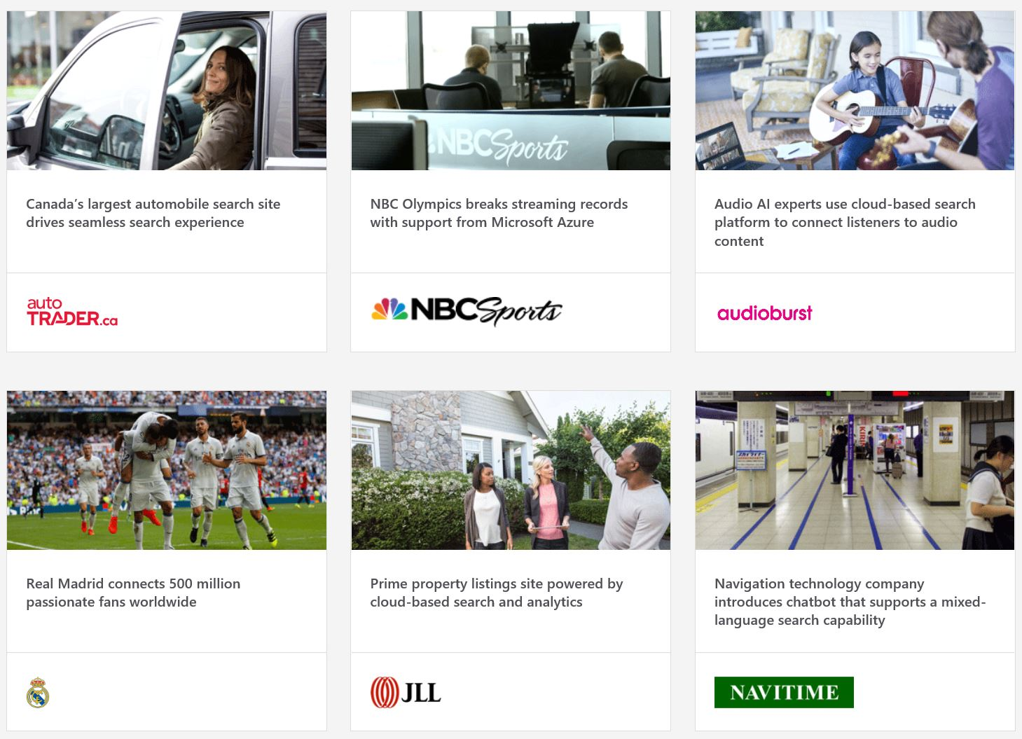
More Customer Stories
Search Stories

Slide 25
Account Targeting
Notes:
KJ + AVP

Slide 26
Research and Targeting
Top Targeting Scenarios
Customers using App Services & no Azure Search
Current Azure Search or Cognitive Services Customers to add additional Search scenarios
Customers with (Cosmos DB, Azure Data Lake, or Azure Blob Storage) and no Azure Search
Targeting Resources
Account Grid with AI Targeting
MegaMap for AI
Five key target personas
CDO
Defines big data strategy
CTO / VP Engineering
Oversees tech. development
VP of Analytics
Oversee delivery of data science and analytics
Find out the role of your customer contact:
Leverage LinkedIn Sales Navigator
Identify your connection to your customer
Review customer title and map to target personas
Data Architect
Data exploration and analysis at scale
Developer
Data prep and infrastructure
Microsoft Confidential – For Internal Use Only

Slide 27
Customer Conversation Guide
Developers
Solution Architects
BDMs
Pain Points
Inability to quickly and reliably support the business when dealing with scale, and variety of data sources and types
Often spends too much time on updating/reprocessing a search index
Often deals with a messy array of internal siloed applications that they need to navigate
Lack of reliable technology to correlate data that scales
Combining demands for performance with needs of business users
Managing security and governance concerns for data across all environments and formats
Speed of projects from roll out to production
Challenges combining structured and unstructured data from multiple sources
Wants to increase the pace of the business, and sorting through information is the bottleneck
Wants to avoid investing headcount and resources on manual tasks to process, store, and categorize archival or unstructured information
Needs to combine internal and third-party enrichment data to gain better insights
Seeks competitive AI advantage, but struggling to understand how to integrate AI into their business
Knowledge Mining Benefits
Can configure ASAP rather than having to code, increasing productivity
Trouble accessing budget, focus on finding value
Focus on: the investments in the ingestion, enrichment, AND indexing “out-of-the-box” solution, how the value is in having one solution that does it all end-to-end to save time and is easy to configure vs. a painful connection of different solutions
Orchestrate custom AI models and run updates only on the section of the solution you need
Azure Search is built for the scale and performance needs of enterprises, with advanced security and privacy features.
Pre-built indexing and data loading capabilities
Knowledge Mining is an AI solution that grows with you. Instantly access the large and rich Azure AI ecosystem now and add layers of sophistication later
Can be applied to solve a variety of business problems, internal and external
Saves money for the company by reducing time employees are searching for business-critical information, automating redundant tasks, and eliminating the need for teams to process unstructured data

Slide 28
Account Qualification and Key Questions
Budget
What budget do you have to work with for your project?
Authority
Can you tell me about your role at the organization?
What are your challenges today in navigating your information?
What size/amount of data are you’re looking to search through?
Is it structured/unstructured?
What languages does it span?
What key business insights are you looking to understand? Do you have an existing use case in mind?
How often is the data updated?
How do you want to surface this knowledge?
Where is your data located?
Explain current inefficiencies that exist
Need
Is there a timeline for your current project?
How and when would you like to evaluate Azure Search further?
Are you interested in having a more technical deep dive conversation?
Timeline

Slide 29
Working With Partners
Notes:
KJ + AVP

Slide 30
Engage Early with Partners
A collaborative selling journey to partner early in the sales cycle and to enable Microsoft and top Partners to drive joint consumption revenue, larger and more strategic projects, and customer success!
Opportunity is identified by Microsoft or Partner
Joint sales & strategy meetings locally to identify opportunities
Engage together with customers
and stay aligned to progress opportunities
Win Together!
Successful Partnerships & Sales happen when -
We engage early, strategize to uncover key opportunities, and consistently align and stay connected throughout the sales cycle to close.
Microsoft
Partner
Microsoft
Partner
Microsoft
Partner
Microsoft
Partner

Slide 31

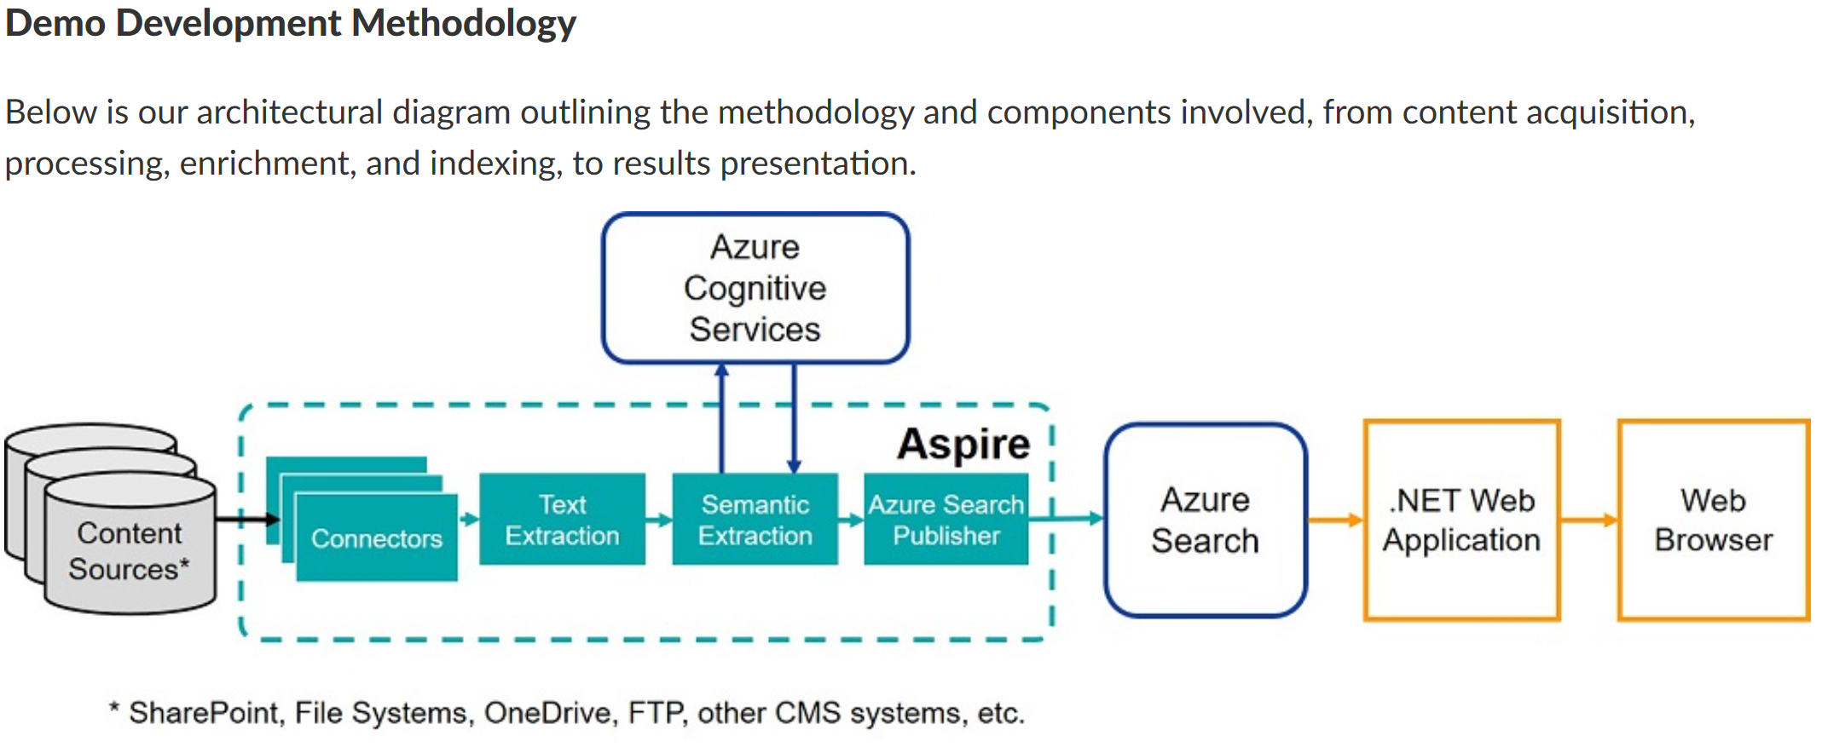
Key SI Partner – Solution Benefits & Value
Built on Microsoft
Accenture Aspire + Azure Cognitive Services is Transforming Unstructured Data Preparation for Azure Search
Back
Accenture's Aspire is a search engine independent content processing framework designed specifically for unstructured and semi-structured data. Aspire utilizes Azure Cognitive Services, a set of intelligent on-demand services that can be connected to websites/applications via APIs for customized business requirements.
Customer value prop
By integrating Accenture's Aspire with Microsoft Azure Cognitive Services, we can accelerate unstructured content acquisition, and significantly enhance content processing and enrichment in Azure Search.
Combining Azure Cognitive Services with Aspire's sophisticated content processing capabilities provides a high-performing data preperation experience.
Accenture

Slide 32

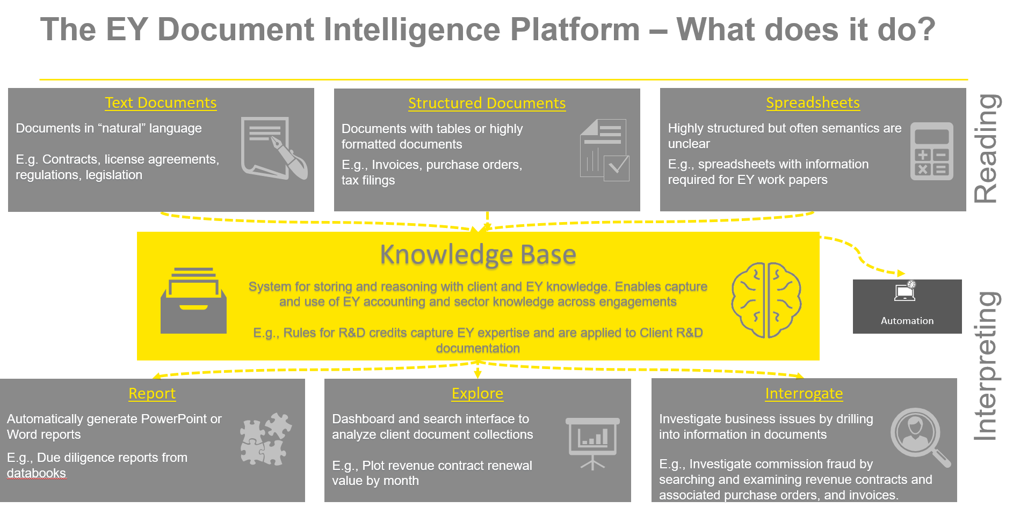
Key SI Partner – Solution Benefits & Value
Built on Microsoft
Microsoft Azure Search
Azure Cognitive Services
Azure Data Lake
Azure Machine Learning
Azure Data Factory.
OSS Data Science
Azure Blob Storage
Cosmos DB
Analytics, ML
Power BI
Azure Bot Framework
Why EY?
EY reads more business documents than any company in the world
Deep expertise interpreting and analyzing business documents and making the appropriate decisions
EY has access to massive amounts of robot training data
Cross industry solutions
Customer Value Prop
Deep learning makes possible humanlike reading and interpreting of documents.
Deep learning makes human competitive reading and interpretation of business documents possible.
EY's Document Intelligence Platform enables organizations to process structured documents by extracting relevant data elements into a format that enables automation which enables efficiencies in an adaptable and scalable architecture.
EY

Slide 33

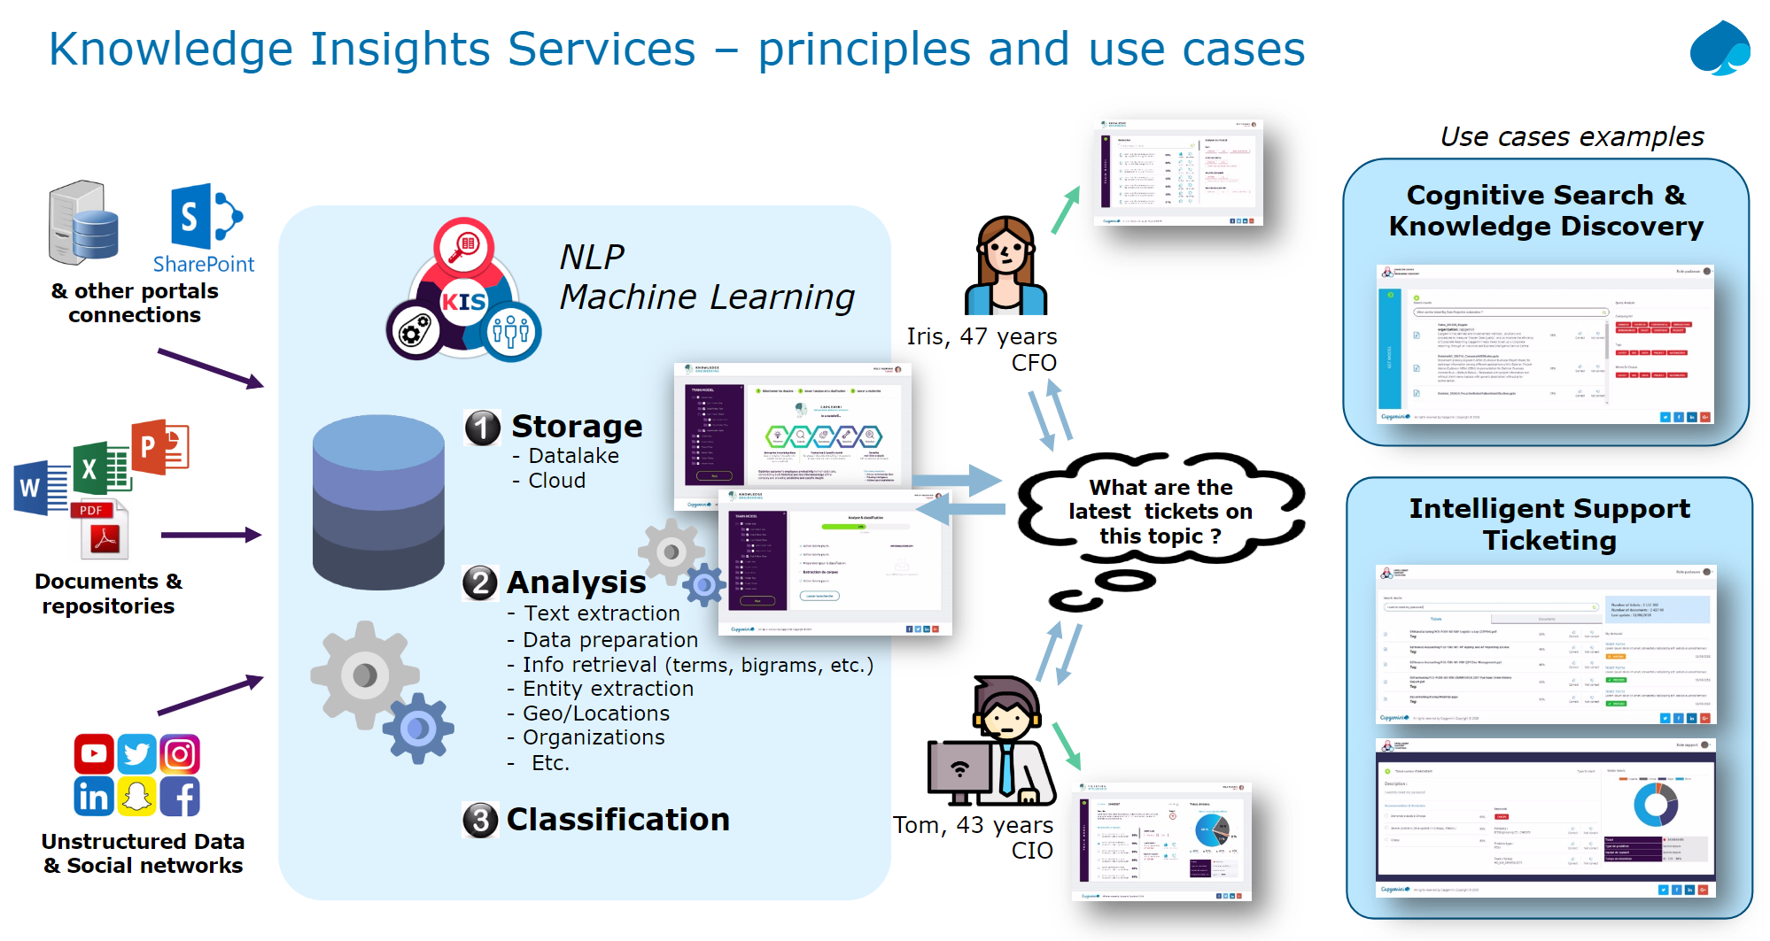
Key SI Partner – Solution Benefits & Value
Built on Microsoft
Capgemini’s approach to knowledge management integrates innovative processes, tools and solutions.
To ensure cost-effectiveness and rapid adoption, Capgemini’s customized processes can include:
Integrated architecture framework, to approach and govern all enterprise information management initiatives
Knowledge management roadmap and scorecards, to assess your business and technology needs
Rapid design and visualization toolkit, to rapidly validate requirements and compress design time cycles
Customer value proposition
Controlling and leveraging information assets that are not stored in documents is proving a challenge for many organizations. Capgemini’s Knowledge Management solutions help you manage your intellectual or “human” knowledge to reduce information loss caused by attrition or staff turnover.
Capgemini

Slide 34

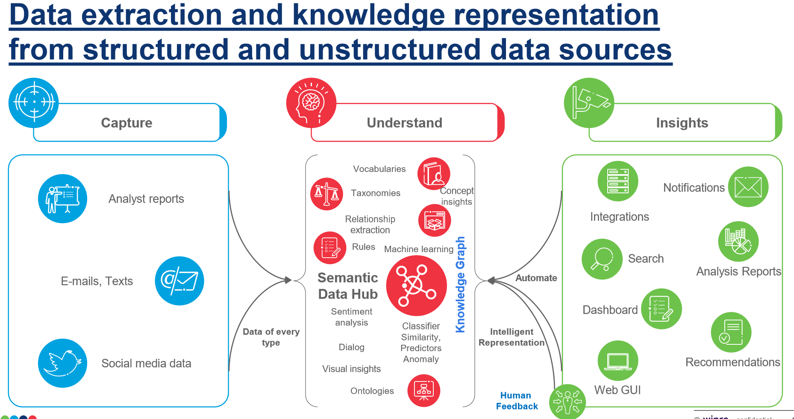
Key SI Partner – Solution Benefits & Value
Built on Microsoft
Wipro's Semantic Data Hub combines image processing, natural language processing, Machine Learning and rules to automatically classify and extract information in realtime from disparate sources and varying formats with little or no human interventions and deliver to users to make business decisions faster.
Solutions Include:
Media and Image Analytics: Extracting meaningful information from images
Information Extraction & Insights: Extracts information from documents
Smart Data Lake: Intelligent data catalog service
Video Analytics: Real time video analysis and detection service
Customer value proposition
Collects and organizes all data assets by making data simple and accessible creating a trusted analytics foundation understanding underlying ideas and concepts.
Wipro

Slide 35

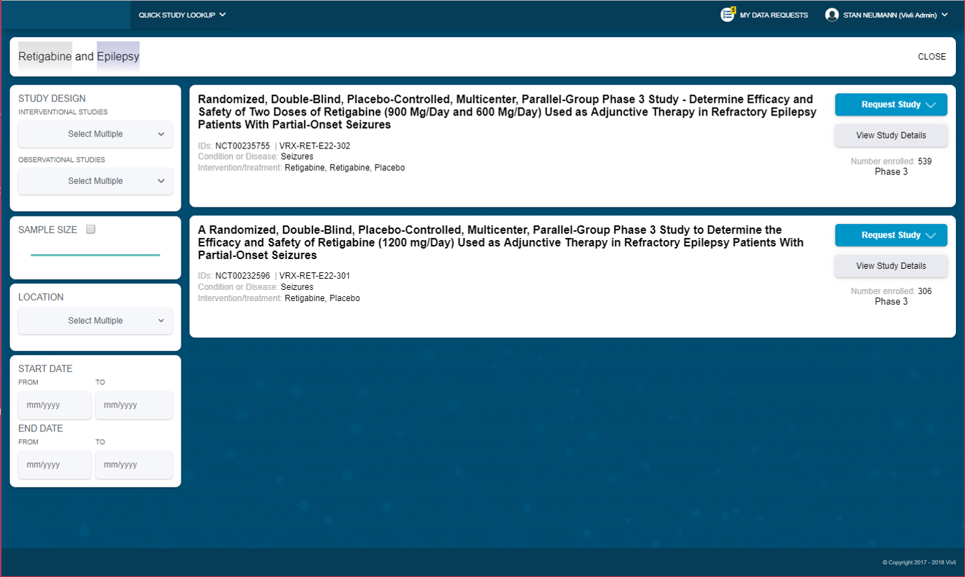
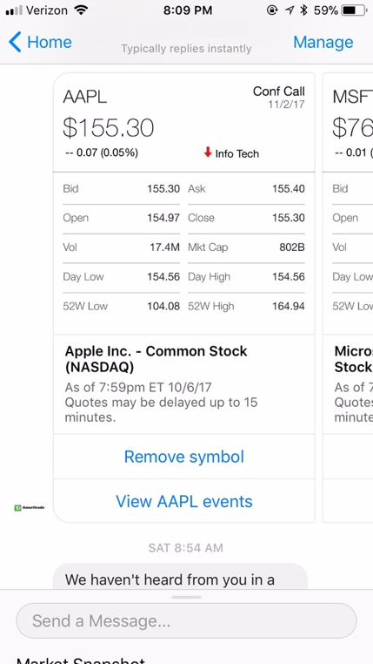
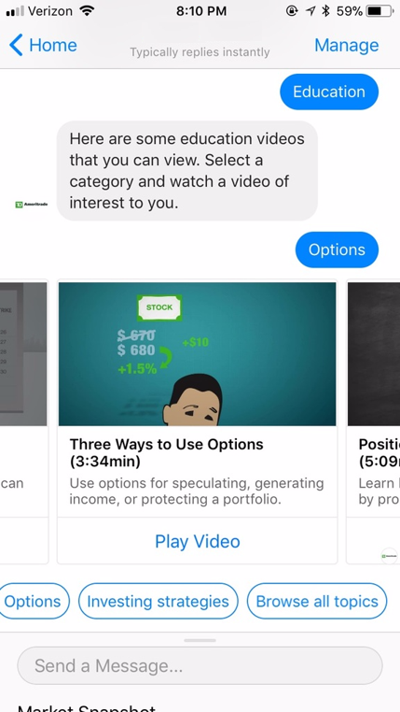
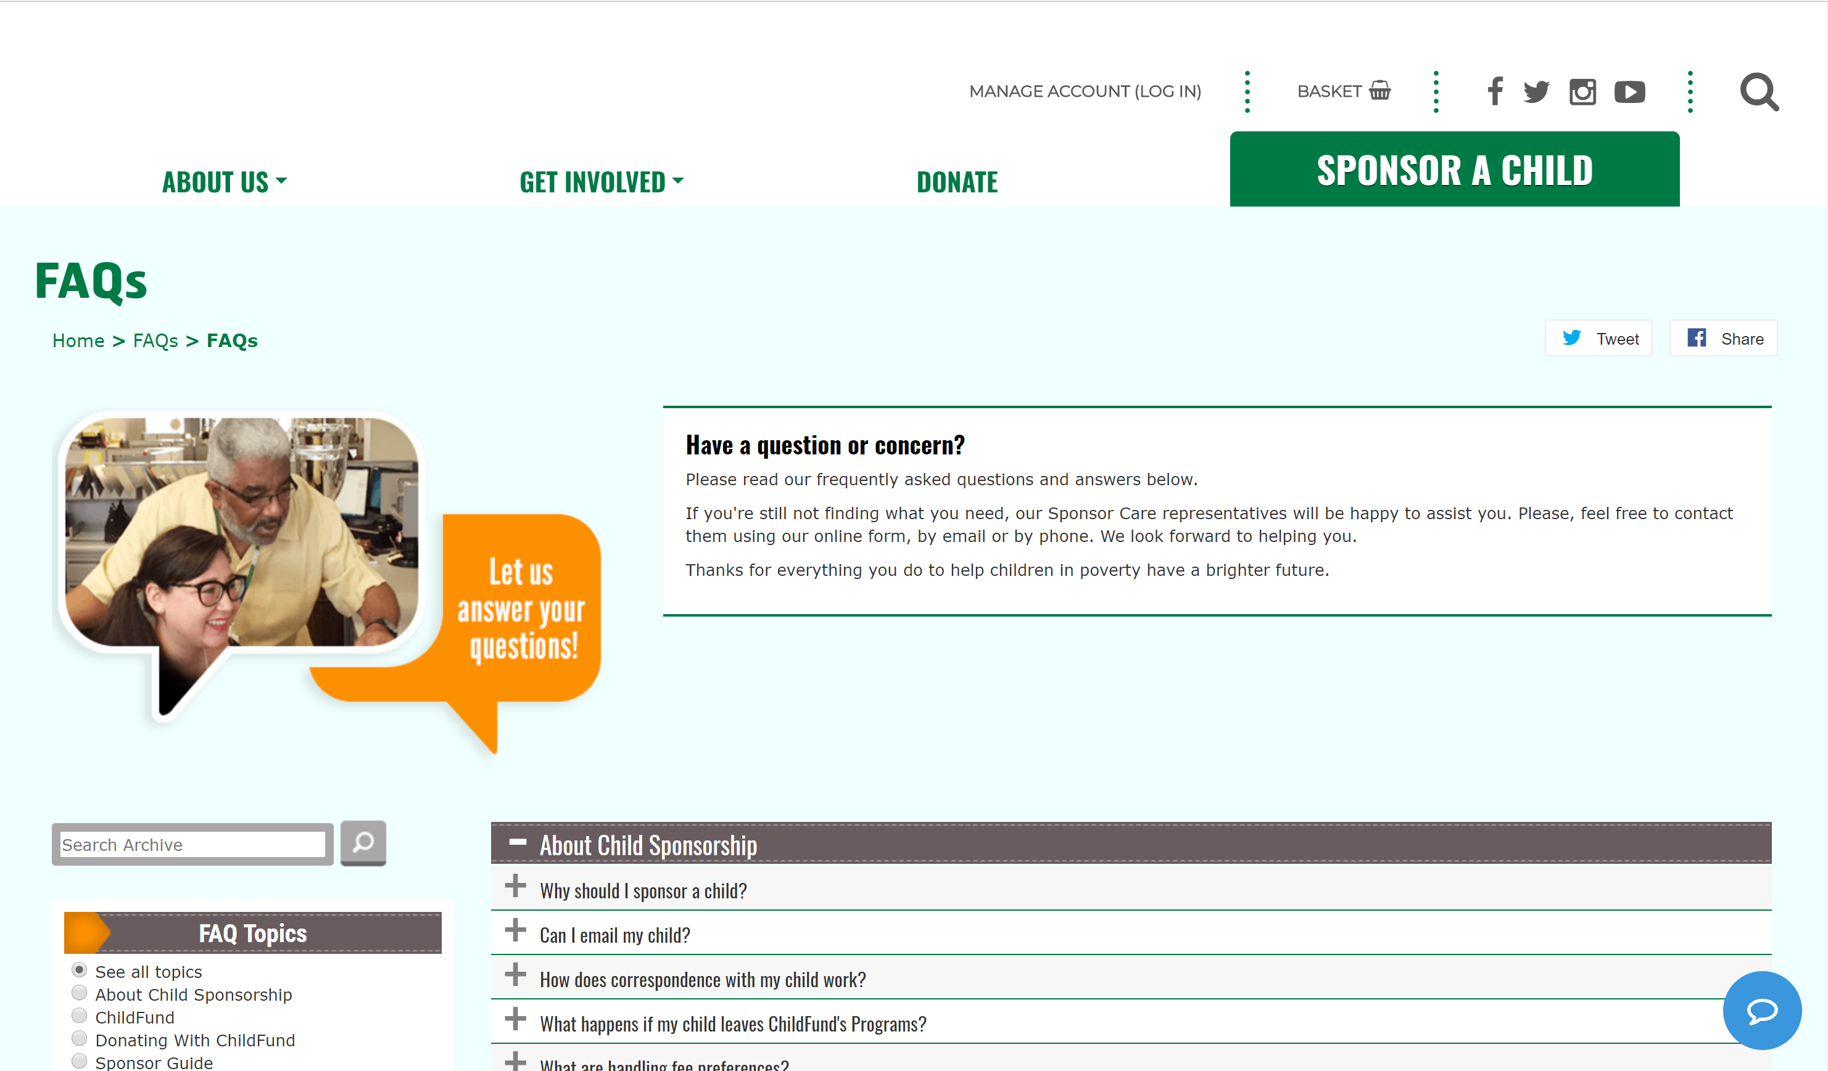
Key SI Partner: Solution Benefits and Value
Built on Microsoft
Leveraging Azure tooling lets us go further, faster:
Cognitive Services
Search
Cosmos
Data Factory
Data Lake
Databricks
Functions
Logic Apps
Service Bus
ML Services
Cloud native approach lowers entry bar and TCO
Extensible to hybrid cloud and cross cloud patterns
Customer value prop
Capture new value from existing data
Proven success and established patterns
Enable workforce, engage customers and optimize business
Deep foundation in identity, security and compliance needs
Agile approach to be tailored to customer’s specific needs
Provide metadata foundation for repeated wins with AI
Process to accelerate solutions from PoC to pilot to production
Focus on minimizing time to visible value creates cadence of success
BlueMetal and Cardinal are Insight Digital Innovation:
Data & Artificial Intelligence
IoT & Edge Intelligence
Modern Applications
DevOps
Emerging Technology
Proven customer success
Clinical trials data hub
Self serve customer agent
Policy mining and searching
Contact us: alliances@insight.com

Slide 36
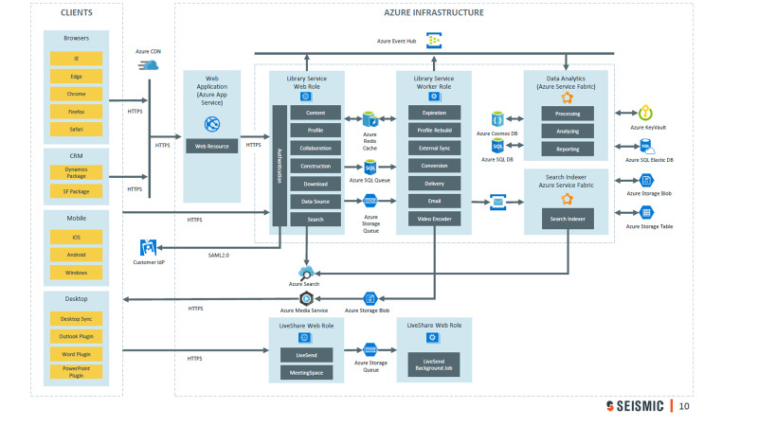
Key ISV Partners – Solution Benefits & Value
Built on Microsoft
Compute Infrastructure:
Utilizes Microsoft Azure PAAS Infrastructure
Web Roles host secure web services utilized by clients
Worker Roles performs long tasks from queries
Isolation (machine, fabric, VLAN) protects operating environment
Audit Logs
All actions by system are logged and available in audit/usage reports.
See Reference Architecture for all solution included services.
Customer value prop
Seismic’s leading sales enablement solution allows marketing teams to personalize content at scale and equips sales teams with the right content for every interaction, dramatically improving time spent selling and win rates. Real-time analytics and machine learning algorithms provide unprecedented insight for marketing teams looking to gauge which content helps close deals, further aligning marketing and sales efforts.
Seismic

Slide 37

Key ISV Partners – Solution Benefits & Value
Built on Microsoft
Icertis is 100% Built on the Microsoft Cloud
Microsoft Azure, SQL, BLOB Storage
Analytics, ML
Compute, VMs
Data & Storage
Microsoft Dynamics AX
Power BI
MS AI/Intelligence – Cognitive Services, TXT, Search API)
For full list and roadmap click here
2018 ACR Impact
Icertis will closed FY18 with more than$10M of ACR impact for Microsoft sellers.
Customer value prop
Icertis is transforming the foundation of commerce with AI-infused live contracts that:
Enable automatic extraction of all the attributes and clauses from legacy and third-party contracts
Help customers to manage the lifecycle of their Contractual Obligations, Risks & Compliance.
Help customers to discover and digitally manage all entitlements & commitments towards their customers, vendors and other entities throughout the lifecycle (Obligation AI app)
Enabling data transformation, the ICM platform is:
Easy - robust authoring and approval routing tools allow customers to prepare, execute and manage contracts easily and reduce contract cycle times.
Intelligent – AI-powered, the ICM platform provides ongoing contractual insights throughout the contract lifecycle, increasing compliance and improving governance and productivity
Enterprise-wide – Designed to provide enterprise-wide visibility into contracts, companies can manage any type of contract (buy-side, sell-side, corporate) anytime, anywhere.
Icertis

Slide 38
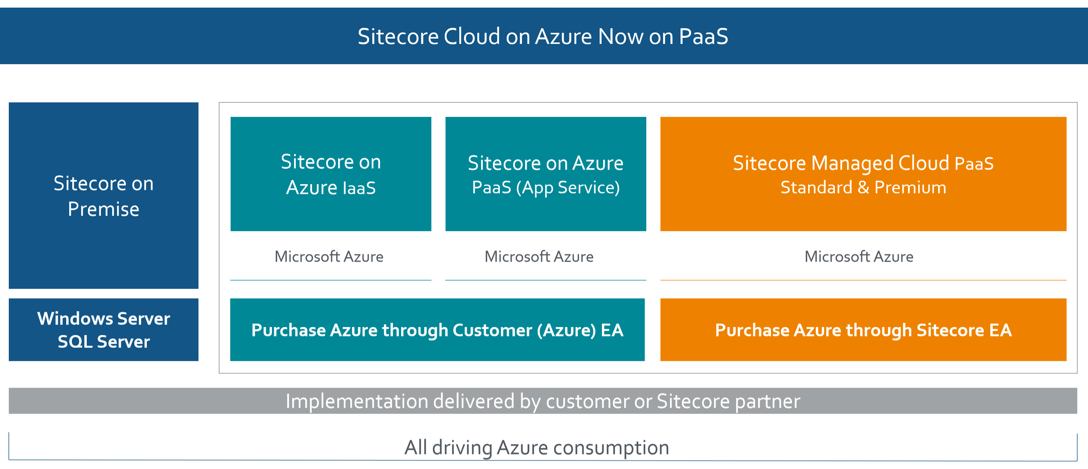
Key ISV Partners – Solution Benefits & Value
Built on Microsoft
Microsoft Azure Cloud Services
App Service
Azure SQL DB
Azure Search
Machine Learning Studio
Cosmos DB
…
Customer value prop
Sitecore’s market-leading web content management (Sitecore Experience Manager) system was built from the ground up as an integrated platform to support global, multilingual content at scale and provide the flexibility that enterprises demand. It’s easy to use for marketers but also open and powerful for IT teams that want to customize, manage, integrate, and secure even the most demanding of websites.
Sitecore

Slide 39
Current Partner Ecosystem
Top GSIs & Key Influencers
SIs Currently Using Azure Search
Cross Geo / Cross industries | EY KPMG Accenture
Geos | NSIs | GSIs
Australia | Diaxion Readify Limited Bulletproof Datacom | Accenture / Avanade
Canada | Softchoice Long View Systems CTO Boost
France | Cellenza Arolla Edifixio Access IT | Capgemini Accenture
Germany | SoftwareONE AG Comparex | Accenture
UK | Sol-Tec Ltd New Signature Trustmarque Solutions Ltd SoftwareONE AG Elastacloud
US | Blue Granite Capax Global: Market Intel Blue Metal/Cardinal/Insight Neal Analytics Neudesic: Document Intel | HCL Accenture Infosys
Other GSIs that should be considered WW |  | Cognizant TCS Wipro
GISVs Currently Using Azure Search
Financial services | Manufacturing | Health Care
Wolters Kluwers Temenos Finastra Spark Beyond | Schneider Electric ABB Bentley Schlumberger | Axon Allscripts Epic Cubic Corp
Retail | Cross-industry | Others
Walmart Apptus | Sitecore SAGE Thomson Reuters Episerver Scalable AI platform | Icertis Seismic Coveo Apptus
Use OCP Catalog to Contact Partners for Engagement

Slide 40
Partner Ecosystem Growth Plan
Strategy
Grow Partner Capacity, Value & Differentiation
Target
Leverage known ISVs & SI’s & grow coverage with local partners across A14
Develop
Training and evangelism to accelerate partner certs and capabilities.
Approach
Develop subsidiary engagement model to scale
Accelerate
Partner led training targeted training, “partner wins”, use cases
Execution
Consumed Revenue: Partner Influenced
Notes:
Grow Global SI Coverage through GSIs
Develop Area SI’s: Top Local SI’s for A14
Industry: Top Industry Solutions

Slide 41
Engagement & Execution Guide
Notes:
KJ + AVP

Slide 42
Microsoft Engagement Process
STAGES
PLANNING
DISCOVERY
ENVISION
VALIDATE
COMMIT
ONBOARD
REALIZE VALUE
ROLES
Microsoft
AE, DA, SE, ATS, SSP, SSSP, ISE, CSM, ECM
Microsoft
AE, DA, ISE, ATS, SSP, SSSP, ECM, GBB
Microsoft
AE, DA, ISE, SSP, SSSP, TSP, GBB, CSE Architect, ECM, AI Ambassadors
Microsoft
SSP, SSSP, DA, ATS, TSP, GBB CSE Architect, ECM, AE
Microsoft
AE, SSP, SSSP, ECM
Microsoft
AE, ADE, TAM, CSM, xSA, DA, CSE
Microsoft
CSM, DA, CI COE, MCS, Partners, CSE
Territory Planning
Account Targeting
Targeted Opptys
HiPo/High Propensity
Existing Analytics customers
SQL DW/SQL DB Customers
Confirm new Engagement is opened in MSX and tagged with the relevant AI workload
Data Azure: Knowledge Mining
Conduct customer-facing Discovery sessions
Introduce “Envision the Art of the Possible” session or other face-to-face meeting
Identify potential scenarios for use of Azure Search, Cognitive Search, or other AI scenarios
Envisioning Workshop with customer
Leverage SSP/TSP and other resources
Validate and prioritize scenarios
Leverage Partners or MCS to deliver envisioning session
Perform Business Value Assessment
Quantify potential economic value
Analytic maturity assessment
Determine customer’s feasibility and roadmap
Create comprehensive proposal
Document progress and artifacts in customer planning tools
Confirm customer EA agreement
Define consumption targets for initial projects
Train customers on how to best leverage Azure AI
Integrate additional Azure services into the process
Explore new solution areas where we can apply Azure services
Develop ongoing care and management processes for customer
Regular checkpoints with customer on usage
ACTIVITIES
Planning and Targeting Resources
Microsoft
Account Grid
Mega Map
Growth Planning for Sellers (GPS)
AI GTM Portal
Discovery Resources
AI sales play
Designing AI with Microsoft values
Solution Maps
DT/Industry POV
Book of Dreams
Envision the Art of the Possible
Envisioning Resources
Joint customer engagement
security review
POC (DB, MCS, Partner)
GBB TSP
AI for all
Vision Demonstrator
Industry Playbooks
DT Workshop
Selling Through Storytelling
Validation Resources
Business Value Assessment
Digital Maturity Model
Commitment Resources
Implementation and Adoption Plan
Onboarding Resources
Licensing Specialist
Account Teams
Growth Resources
Partners
MCS Services
RESOURCES
Some Resources may be only available internally at Microsoft

Slide 43
Pricing and Consumption Drivers
Maximize # of search units
Maximize the SKU
Drive max volume of information the entire service can handle, or the max speed/capacity to index the service can perform
Maximize the # of services
Create multiple search scenarios, internal/external solutions, target multi-market customers, learn about regions where end scenario is operating

Slide 44

Consumption Driver Details
Partitions
Volume vs. performance
Azure Search is paid by number of Search Units (SU) provisioned, NOT by the amount of indexing/end user activity. SUs are combinable units where you can have up to 12 as partitions and 12 as replicas. Adding partitions increases the volume of information you can index. Replicas will increase the throughput, or speed at which you can index a given amount of information.
Replicas
SKU ranges
The speed of indexing that a Search Unit can handle depends on SKU (S1/S2/S3)
S1 SKU
S2 SKU
S3 SKU
25 GB
50 indexes
100 GB
200 indexes
200 GB
1000 indexes
Adding services
The number of Azure Search services will drive revenue. A customer will want to create multiple services in order to:
Optimize on scenarios for their business. If one search solution requires a high volume of speed to index over a medium amount of data, they will create service 1 separate from service 2, which is searching over a large amount of data but only a small group of people need to index it or index it infrequently.
Segment between external and internal applications
Serve multiple markets.

Slide 45
ECIF Guidance
The ECIF policy guide can be found at this link
ROI for ECIF requests for AI workloads is 1.5-2.5x vs. 10x for other workloads
ECIF request are to be made through the OneAsk process via the OneAsk Portal
ECIF requests must be made by sales teams in the country where it will be utilized
ECIF is defined as monetary funding of, or payments for, services delivered to Microsoft end-customers in support of Microsoft products, to drive deployment or migration of MS products, or provide support or Product Quality Remediation (“PQR”)

Slide 46

CSE Team
Commercial Software Engineering
CSE has developed capabilities around Knowledge Mining and has delivered a number of Knowledge Mining projects
CSE typically engages on S400 and Global ISV 120 accounts
Depending on needs there are several approaches that can be taken
Begin with an Architecture Design Session
Open Hacks are being developed and may be deployed on a case by case basis
CSE Contacts https://microsoft.sharepoint.com/teams/CSEHub/Pages/CSEContacts.aspx

Slide 47
CTA & Field Resources
Call To Action
Utilize the AI engagement process and tools
Identify 3-5 new Knowledge Mining Opportunities for initial discussions
Determine which partners you would like to leverage for each opportunity and engage them early
Set and conduct an envisioning session with customers to qualify the opportunity or deliver via a partner
Leverage TSPs, CSAs, AI Ambassadors and GBB TSPs as needed to move the opportunity forward
Bring top deals to the DWR for support
Resources
Account Targeting
Account Grid | MegaMap
Envisioning Resources
Book of Dreams | Envision the Art of the Possible
Cognitive Search
Documentation | Sign up for Azure Search
Azure ML Package for Text Analytics
Documentation | Create a DS Virtual Machine
Cognitive Services
Documentation | Sign up | Contact
Demos
JFK Files | Wolters Kluwer

Slide 48
Technical Resources
What is “Cognitive Search” in Azure Search
QuickStart Guide
Cognitive Search GitHub location
Associating Cognitive Services with a Skillset
Azure Hero Solutions – Knowledge Mining in AI Solutions section

Slide 49
Appendix
Notes:
KJ + AVP

Slide 50
Product Update Roadmap
Product Milestones
Q2
Q3
Q4
Q1
Oct
Nov
Dec
Jan
Feb
Mar
April
May
June
Large data SKU private preview
Fairfax
Private Preview
Fairfax Public Preview
Grok announce
Fairfax
GA
Large data SKU public preview
Large data SKU GA
Customer Managed Keys (Encryption) Preview
VNets Public Preview
Cog Search GA
Complex Types Public Preview
AutoComplete GA
Internal Only

Slide 51
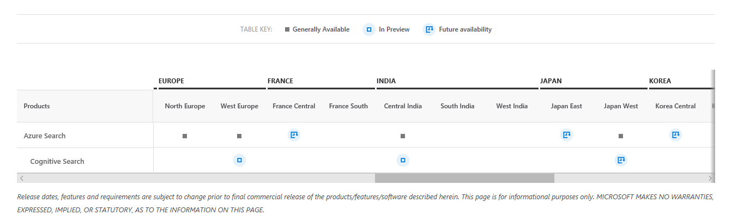
Region Availability
Full region availability information for Azure Search & Cognitive Search can be found below (includes roadmap):
https://azure.microsoft.com/en-us/global-infrastructure/services/?products=search&regions=all

Slide 52
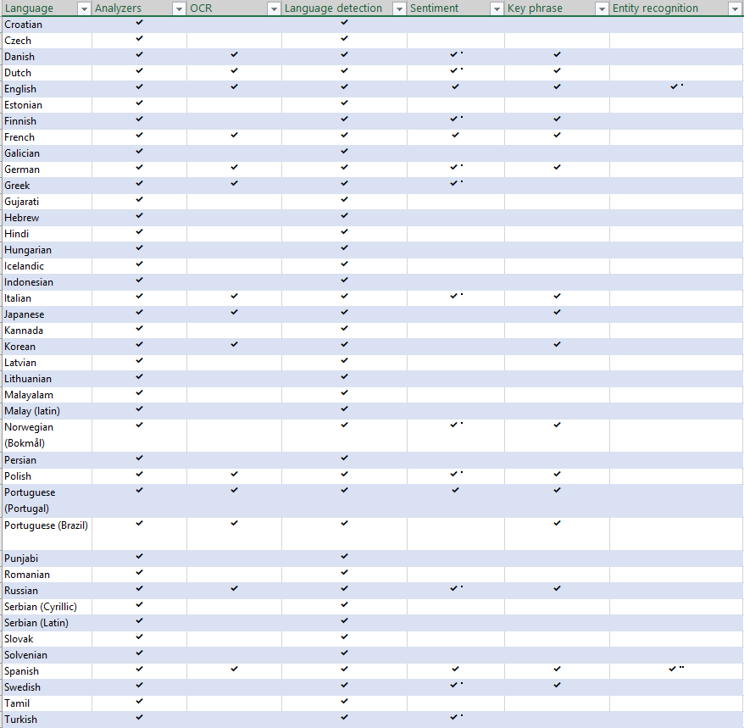
Language Support Across Capabilities
Core Azure search scenarios (leveraging text and information from data to create search index + end user search functionality) is supported in 51 languages
Cognitive services (OCR, Sentiment, key phrase extraction, sentiment) are available in select languages
You can use this pivot table to see language support across capabilities Knowledge Mining_Language support.xlsx

Slide 53
Product Differentiation
Feature/benefit | Azure Search* | Amazon ElasticSearch Service* | Elastic Search/Solr | Elastic Cloud* (Hosted on AWS, or GCP) | Google Cloud Search
Optimized for their cloud solution |  |  |  | 1/2 | 
Ability to run on prem |  |  | 
Has Elastic Search head and ecosystem support |  |  |  | 
Easy to deploy and manage |  |  |  | 1/2 | 
Rich search features: Sorting /Ranking/Attribute Boosting |  |  |  |  | 
Integrated document cracking service (PDF, DOC, etc.) | 
Natural language APIs integrated |  | ** |  |  | **
Vision APIs integrated |  | ** |  |  | **
Ability to connect custom AI models with search | 
Advanced analyzers with deep language understanding |  |  |  |  | 
*Built on elastic search
**Have their own set of AI APIs that are not integrated with search offerings

Slide 54
FY19 Data & AI – Offer Walk
Key
Plays
SOLUTION AREA STACK
PILOT / FOUNDATIONAL OFFER
HORIZONTAL AND INDUSTRY SOLUTIONS POWERED BY THE FOUNDATIONAL OFFER
AI-Cognitive
SCENARIOS, USE CASES, STORIES, CONVERSATIONS
INDUSTRY SCENARIOS, USE CASES, STORIES, CONVERSATIONS
AI-Bots
Intelligent Experiences with Bots
Get Smart
AI-Machine Learning
Personalization
B&C Mkts: Banking Platform as a Service
PubSec: Student Analytics
Digital Ready for Analytics
Demand Forecasting
B&C Mkts: Next Best Action for Insurance
Retail Customer Insights
Predictive Analytics Essentials
Customer Insights & Experience
B&C Mkts: Next Best Action
Healthcare: Clinical Analytics
Patient Volume Forecasting
B&C Mkts: Online Fraud Detection
Healthcare: Operational Analytics
Student Analytics
Retail: Inventory Optimization
PubSec: Digital Incident Response Solution
Predictive Maintenance
Manu: Predictive Maintenance
IOT
Internet of Things Advanced
Predictive Maintenance
Manu: Predictive Maintenance
Get Connected
Connected Assets & Remote Monitoring
Manu: Connected Field Service
BI Reporting & Visualization
Supply Chain Insights
PubSec: Govt Mobile Worker Productivity
BI Visualization Essentials
Analytics for Telco
B&C Mkts: Risk Analytics
Manu: Supply Chain Visibility
Get Ready
Data
SQL Upgrade
Risk and Compliance Management
Oracle Compete
Data Warehouse Modernization
Notes:
Data & AI Stack
Manufacturing Focused Solutions are Highlighted
This slide gives you an end-to-end view from Key Plays down to Offers and Industry Solutions. The clear message here is that we have a solid set of IP and Offers to land in front of customers. However it is super, super important that we always start with a Strategy Briefing and Envisioning Session: With AI we often miss the larger opportunity when we don’t get the customer to invest in a strategy briefing to uncover the core business issues – missing this step can lead to a ‘one and done’ result. The Path to Value approach should guide all of our engagements with customers.

